Slide 1
IST256 : Applications Programming for Information Systems
Fall 2018
Mondays 9:30am -10:50am Prof. Michael Fudge
Course Introduction

Slide 2
Agenda
Introduction
How this course is organized?
Goals of This Course
Let's Go Over The Syllabus
How IST256 Works
Next Class

Slide 3
How is this course organized?

Slide 4
Everyone is enrolled in 2 sections
Lecture Section
Recitation Section
Combined.
I'm your lecture Professor
Meet Mondays
We cover new course material in lecture.
Don’t need your laptop, but you do need your smartphone.
You don't write code in Lecture. Too chaotic to try, just watch and most importantly ask and answer questions.
Breakout.
Your recitation professor is of: Ferger, Kadaji, Nosky, Rieks, or Stringer.
Meeting times vary Wed-Fri
We enforce lecture material in recitation.
You must bring your laptop!
You will write code in Recitation. Easier to do because you've seen it in lecture.

Slide 5
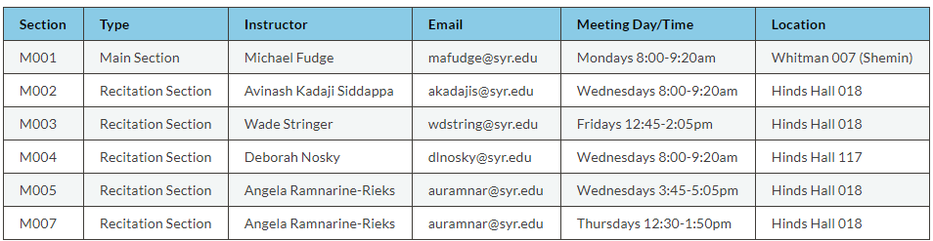
Regardless of your section we are ALL here to help you!
Shemin Aud.

Slide 6
Goals of This Course

Slide 7
We Want You Become a "Modern Programmer"

Slide 8
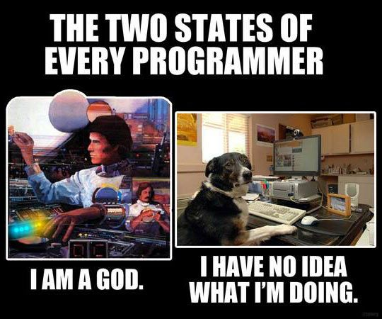
To program in the Python computer programming language.

Slide 9
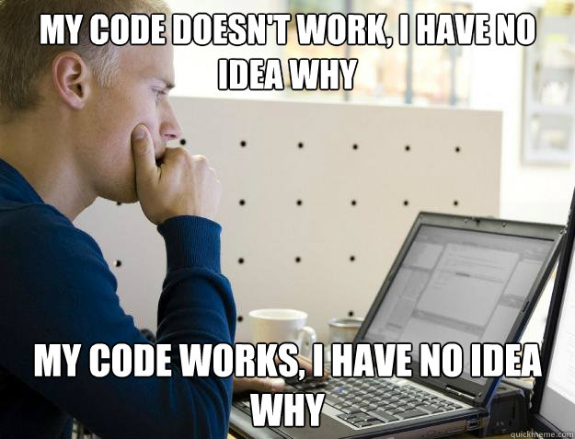
To solve complex real-world, data-oriented problems by writing code.

Slide 10
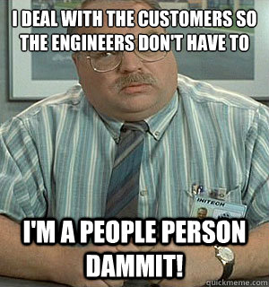
To read, write and discuss code and documentation with confidence.

Slide 11
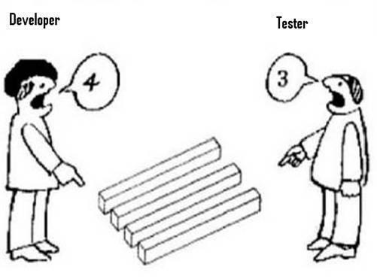
To code in teams, collaborate with others and manage your source code.

Slide 12
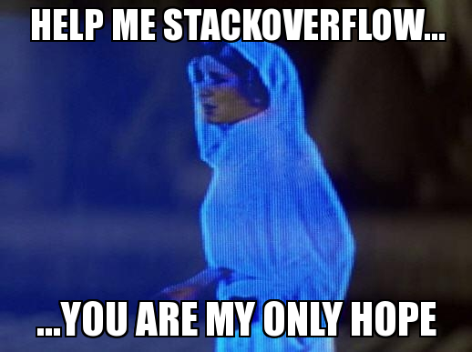
The skills necessary to acquire new programming knowledge independently.

Slide 13
Why Learn To Program?
“TEDxSMU: You Should Learn to Program”, by Christian Genco
https://www.youtube.com/watch?v=xfBWk4nw440

Slide 14
Programming:
Is
Difficult
Time Consuming
Frustrating
Rewarding
Requires:
Practice (lots of it)
Precision
Patience
Persistence
The Key to success is Practice

Slide 15
Let's Go Over The Syllabus!
http://ist256.syr.edu/syllabus/

Slide 16
Textbooks
3 Required.
One is not Free… It's $48
http://ist256.syr.edu/syllabus/#textbooks

Slide 17
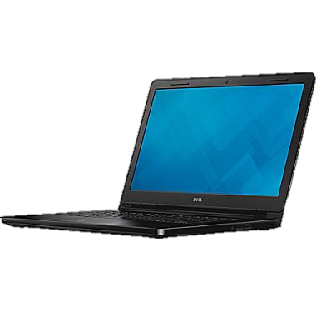
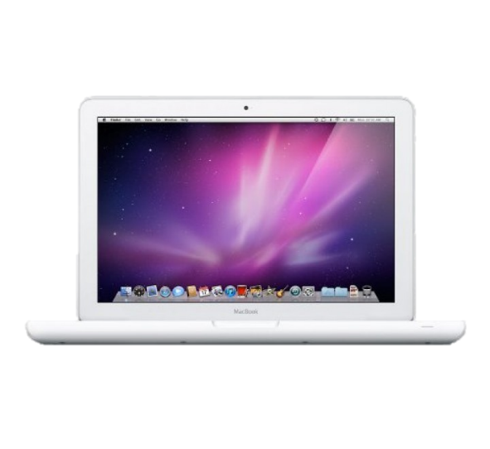
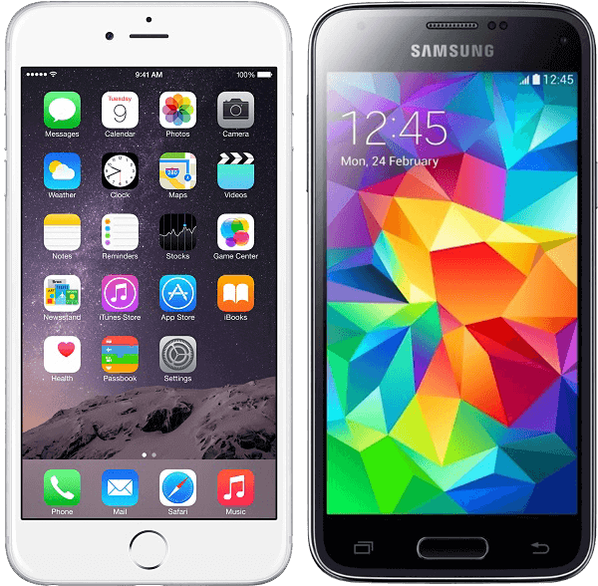
This Class Is BYOD
You will need your Laptop for every class (Both lecture and Recitation).
During lecture
To Participate in Class (answer and ask questions)
During Recitation
To Write Code, of course!

Slide 18
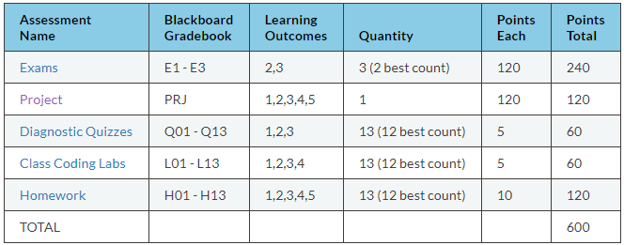
Methods of Evaluation

Slide 19
Exams (E1, E2, E3)
Three exams in the course. Your best two exam scores count towards your final grade.
Exams are delivered in class on the dates posted on the syllabus and class schedule.
Exams are 30 minutes in length, at the beginning of class recitation.
There are no re-issues or make-ups.
Exams are issues on paper as multiple choice questions. Scan-tron forms.

Slide 20
Project (PRJ)
Your chance to show us what you've learned.
Do whatever you like, but run your idea by your instructors first.
Showcase it on Demo Day (posted on Syllabus).
You are expected to work in groups of 2-3 people. Each person on the team should contribute equally.
Create something useful. Think big and follow your passion.
Details on Syllabus and Website!

Slide 21
Demo Day!
https://youtu.be/XSs4yC1TJg0

Slide 22
Diagnostic Quizzes (Q01 – Q13)
Designed to ensure you are keeping pace with your studies.
Issued weekly online in Blackboard. Work alone.
You are issued a subset of questions from a pool of question in the lesson.
You must complete before Wednesday.
5 points each. 2 Attempts, best attempt counts.
Each attempt could have different questions.
You are given one “Free Pass” – Lowest score dropped.

Slide 23
Class Coding Labs (L01 – L13)
Labs are your first opportunity to apply the programming concepts we’ve learned.
Labs walk you through the process, step by step.
Complete between lecture and recitation, commit lab to Github BEFORE recitation.
Ask questions at the beginning of recitation
5 points for a completed lab, no Partial credit.
You are given one “Free Pass”, meaning you have one incomplete lab without penalty.

Slide 24
Homework (H01- H13)
Weekly homework. Due at end of lesson week.
Must commit your code to GitHub before class on due date.
A evaluator will check ONE of your assigned homework at random in the beginning of class.
You will know your evaluation at the time your homework is checked, pending verification of what on GitHub.
You are given one “Free Pass”, meaning your lowest homework score is dropped.

Slide 25
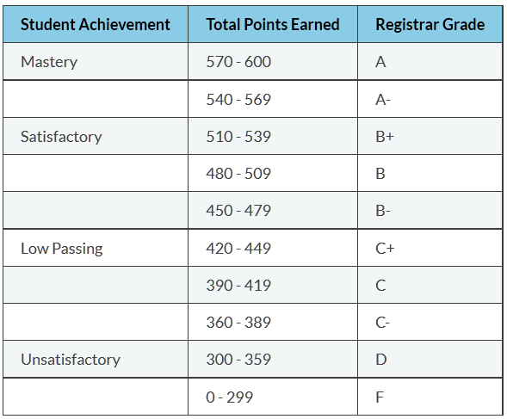
Grading Scale

Slide 26
Class Participation
Attendance will be taken in every class.
You will be expected to participate in lectures and recitations.
In lectures you should ask questions and answer polls.
Attendance does not imply participation, but participation implies attendance!
If you cannot attend class for any reason you will not receive credit for participation.
Participation factors into your grade at the instructor’s discretion.

Slide 27
The 5 "No's"
No excused absences.
No late work.
No make-up exams.
No extra credit.
No rounding up final grades.

Slide 28
Honor Code & Academic Integrity
My work is my own
I will not share answers
I will not misrepresent my ability
I will give credit & attribute sources
I accept the consequences
When in doubt. Ask!

Slide 29
How IST256 Works

Slide 30
Resources we will use in this course
Course Website: http://ist256.syr.edu
All Content is on the website. Links to the other resources we will use such as gitter.im, Blackboard, and YouTube!
Content is searchable.
GitHub Classroom
For accessing code, turning in your work and getting feedback from your prof.
We will learn to code using the tools of real coders.
Blackboard
For taking the diagnostic quizzes; grades posted here.

Slide 31
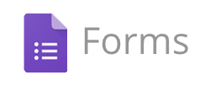
How do I ask you questions?
Each Lecture you will be required to sign-in with your NetID.
During lecture, I ask questions and provide a link where you can answer.
I use your responses to guide lecture.
Your participation is not graded, but is monitored.
Excellent participation can positively impact your final grade in the course at our discretion.

Slide 32
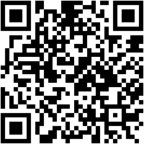
Example Participoll
http://ist256.participoll.com/
How many exams are issued in this course?
One
Two
Three
Four
http://ist256.participoll.com/
0
A
B
C
D

Slide 33

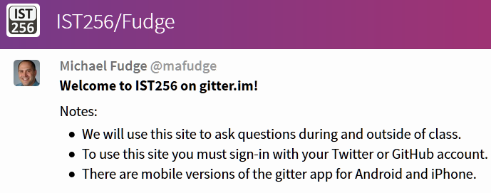
How do you ask me Questions?
Ask Questions in Class, a Moderator brings them up during lecture
Ask questions, and discuss outside of class, too.
Supports Web, iPhone & Android

Slide 34
2 Things To Do Before Your 1st Recitation

Slide 35
1. Account Signups
SU Google
For taking attendance
GitHub
For getting class code and submitting your work to professors
Gitter.im
Community chat channel for asking questions in class and outside of class.
Zybook
Online interactive textbook
Instructions are on the course website.

Slide 36
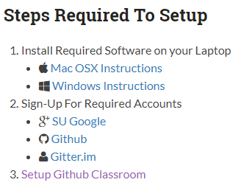
3. Setup your Laptop
Follow the instruction at http://ist256.syr.edu/setup/overview/
You need your laptop ready, we start coding next week.

Slide 37
Agenda For 1st Recitation Class
Meet and Greet
Overview of Course Resources
SU Google Forms
Zybook
Gitter.im
Github
Check Your Setups. You need these setup before next week!
Account Signups
Laptop Setup

Slide 38
SU google forms

Slide 39
Class Attendance
On Lecture days, we'll use SU google forms to keep attendance.
At the beginning of class you will be given a link to the page for the class.
You are also given an attendance code. You must enter the attendance code in the beginning of class.

Slide 40
Testing: SU Google Forms
Class Participation
http://ist256.syr.edu/cp/00.html
Attendance Code for this session:
1234

Slide 41
Gitter.im

Slide 42
Gitter: It's how you ask questions!
https://gitter.im/IST256/Fudge
We'll use Gitter.im for questions. In class and out of class.
It's about conversations with each other, not just us professors!
There will be times during lecture for answering questions.
Gitter.im has an iOS and Android app, too.

Slide 43
Testing: Gitter.im
Say "Hi" on Gitter.im and I'll say "Hi" back.

Slide 44
Zybook

Slide 45
Zybook: Let's See Who's Activated It
Zybooks reports student usage.
I will demonstrate these reports now.
Your team professor will track your usage weekly and flag you in Orange Success if you are not participating.
It's hard to pass the diagnostic quizzes without reading first!
Demo Time!

Slide 46
Opening the Command line on your computer
There are lots of ways to do this
but we provide instructions because they work consistently
please follow our instructions
Videos that explains it:
Windows PC: https://youtu.be/Ze9EmjjHoxU
Mac OSX: https://youtu.be/4NmcFGngyh0
Once you do it a couple of times, it will become 2nd nature.

Slide 47
Check Your Python and Jupyter Setup

Slide 48
Python / Jupyter Installed?
open the command line in your git folder
$ python --version
should be 3.5 or higher
$ jupyter-notebook
should open the jupyter notebook application in a browser window
to exit: close the browser window, then select the terminal window and press CTRL+C two times.

Slide 49
Check your git / github classroom setup.

Slide 50
Check git / github classroom
open the command line in your git folder
$ git status
Should NOT say "Not a git repository" … you're in the wrong folder
or "command not found" … git is not installed
$ git remote –v
Should say origin with URL to your github page.

Slide 51
GitHub Classroom

Slide 52
GitHub Classroom: Submit Homework!
Install Git
Create a GitHub Account
Setup Your Avatar!
Setup GitHub Classroom
Turning in your work is easy!

Slide 53
Testing: Github
open command line in your git folder
$ git status
edit a file
$ git add –all
$ git commit –m "your message"
$ git push origin master
$ git remote –v will show you origin

Slide 54
Next Week: Programming Walk-Through
Explains how you complete labs and homework in this course, then submit them for grading.
L01 – First lab.
Walks you through the process step-by-step
Due day before our next recitation by 11:59pm
H01 – First homework.
You must repeat the process on your own as homework.
Due Saturday by 11:59pm.

Slide 55
Something not setup? Stick around and we will help!

Slide 56
Thank You!
IST256 Fall 2017

